Slide 1
MERIF WORKSHOP ORBIT/COSMOS Introduction (Open Access Research Testbed for Next-Generation Wireless Networks)/(Cloud Enhanced Open Software Defined Mobile Wireless Testbed for City-Scale Deployment)
Michael Sherman, Rutgers University
Slides from Ivan Seskar

Slide 2
Orbit Project Rationale (2003)
Wireless testbeds motivated by:
cost & time needed to develop experimental prototypes
need for reproducible protocol evaluations
large-scale system studies (...emergent behavior)
growing importance of cross-layer protocol studies
creation of communities for wireless network research
ORBIT: open-access multi-user facility for experimental wireless networking research primarily in unlicensed bands
~24/7 service facility with remote access
open interfaces for flexible layer 2,3 & cross-layer protocols
extensive measurements at PHY, MAC and Net layers
support for wide range of radio system scenarios

Slide 3
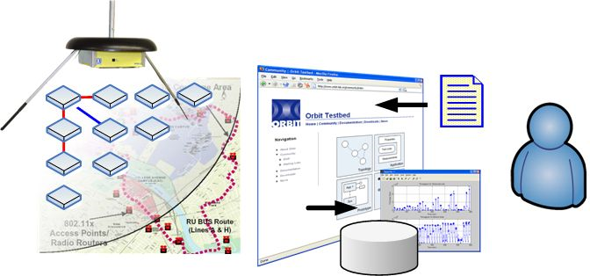
ORBIT
Proposal: Build radio grid emulator (phase I) and field trial network (phase II)
Emulator used for detailed protocol evaluations in reproducible complex radio environments
Field trial network for further real-world evaluation & application trials

Slide 4
Orbit Hardware
VPN Gateway to
Wide-Area Testbed
Gigabit backbone
Front-end
Servers
80 ft ( 20 nodes )
Data
switch
Application Servers
(User applications/ Delay nodes/ Mobility Controllers / Mobile Nodes)
70 ft ( 20 nodes )
Control switch
SA₁
SA₂
SA_{P}
IS₁
IS₂
IS_{Q}
RF/Spectrum Measurements
Interference Sources
Back-end servers
Internet VPN Gateway / Firewall

Slide 5
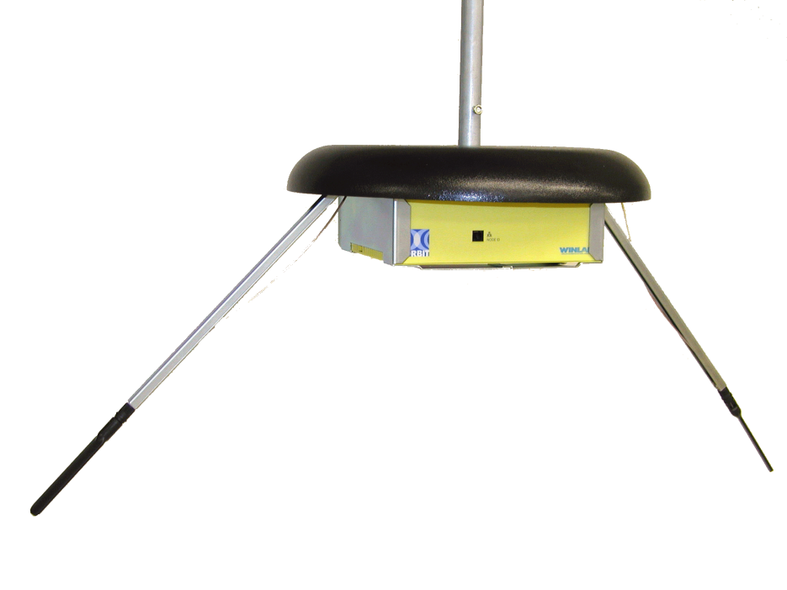
ORBIT Radio Node (2004/2005)
Version 0: COTS:
Proof of concept
Prototyping platform
Version 1: Custom design:
Functional requirements
Manageability
Power consumption
Cost
Version 2: Custom design with other attached devices:
Bluetooth
ZigBee
GNU Radio
Intel/Atheros
miniPCI
802.11
a/b/g
Intel/Atheros
miniPCI
802.11
a/b/g
1 Ghz
512 MB
RAM
CPU
VIA
C3 1Ghz
PCI
Gigabit
Ethernet
(control)
20 GB
DISK
Gigabit
Ethernet
(data)
22.1Mhz
110
VAC
Serial
Console
Power
Supply
CPU
Rabbit Semi
RCM3700
10 BaseT
Ethernet
(CM)
pwr/reset
volt/temp
+5v standby
RJ11 NodeIdBox

Slide 6
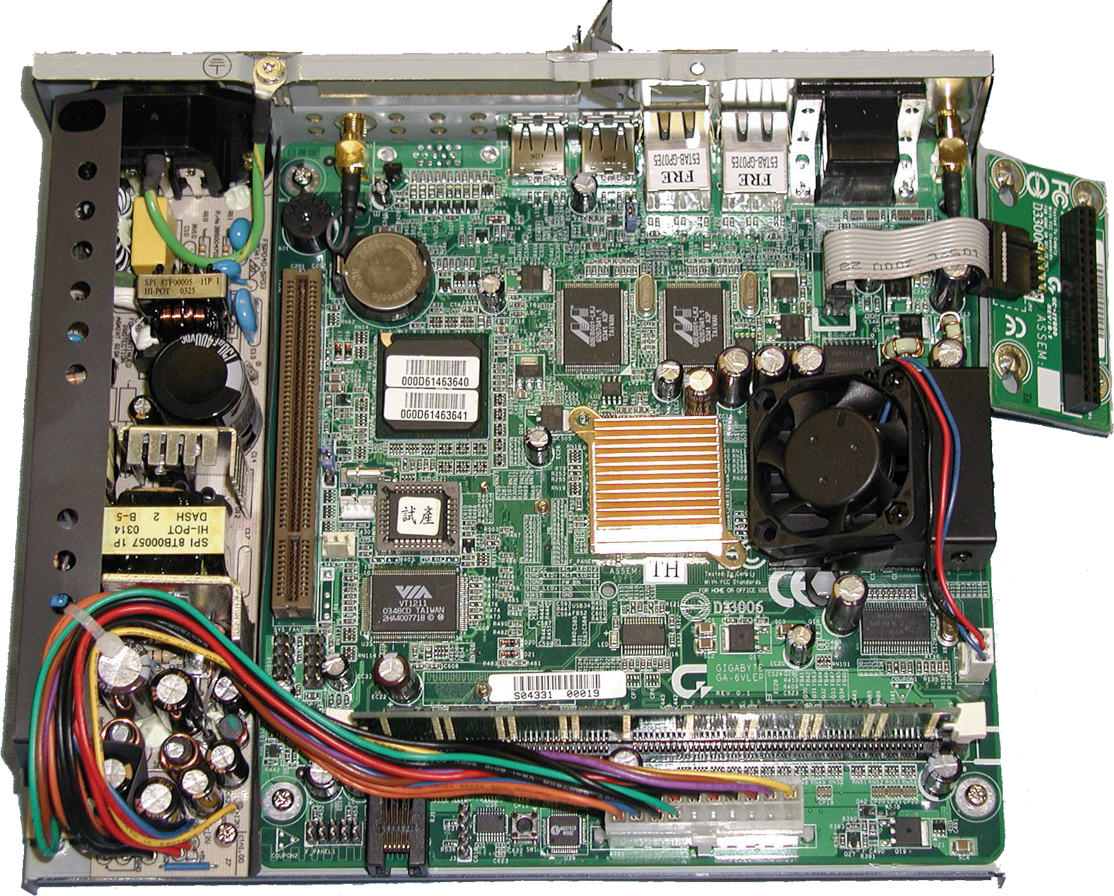
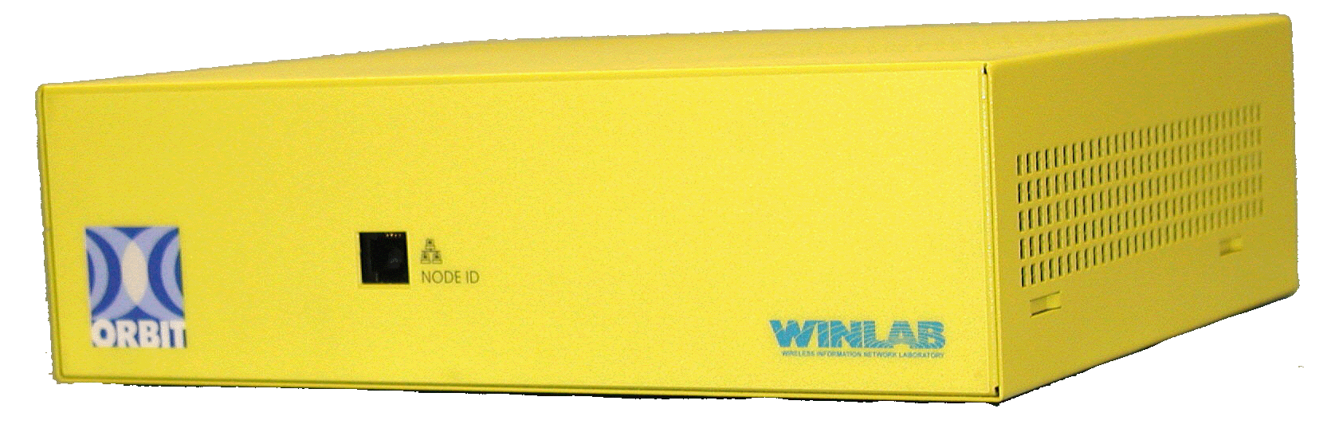
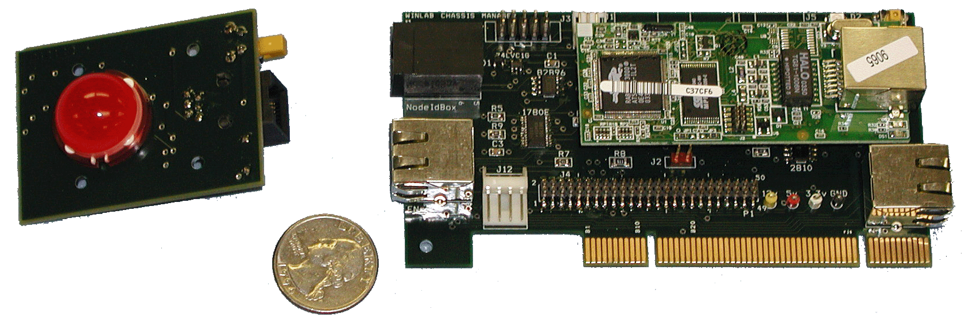
ORBIT Radio Node Gen 2 Photo Album
ORBIT Radio Node
with integrated Chassis Manager
Non-Grid Node
Chassis Manager

Slide 7
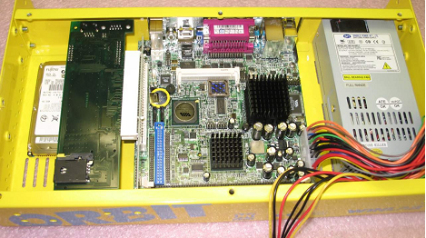
Version 2.5: Back to COTS (2007)
The COTS 2nd generation node:
Off the shelf motherboard
Custom indoor or outdoor (weatherproof) enclosure
Control manager (CM) with optional GPS and GPRS

Slide 8
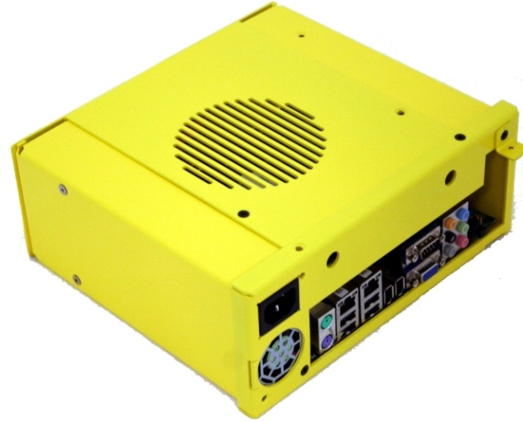
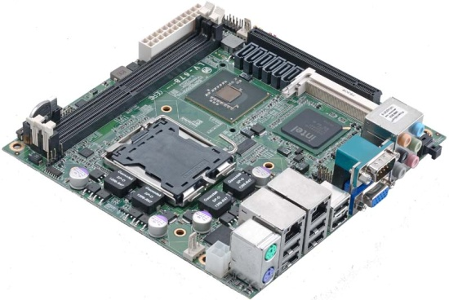
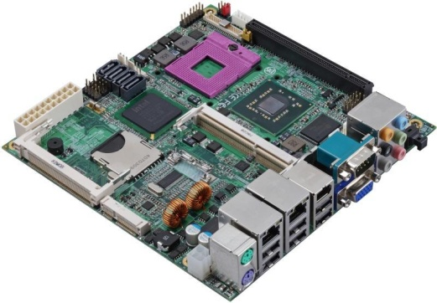
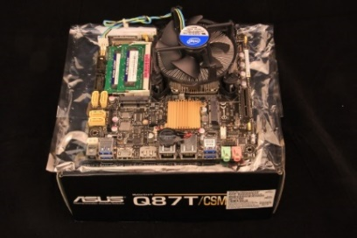
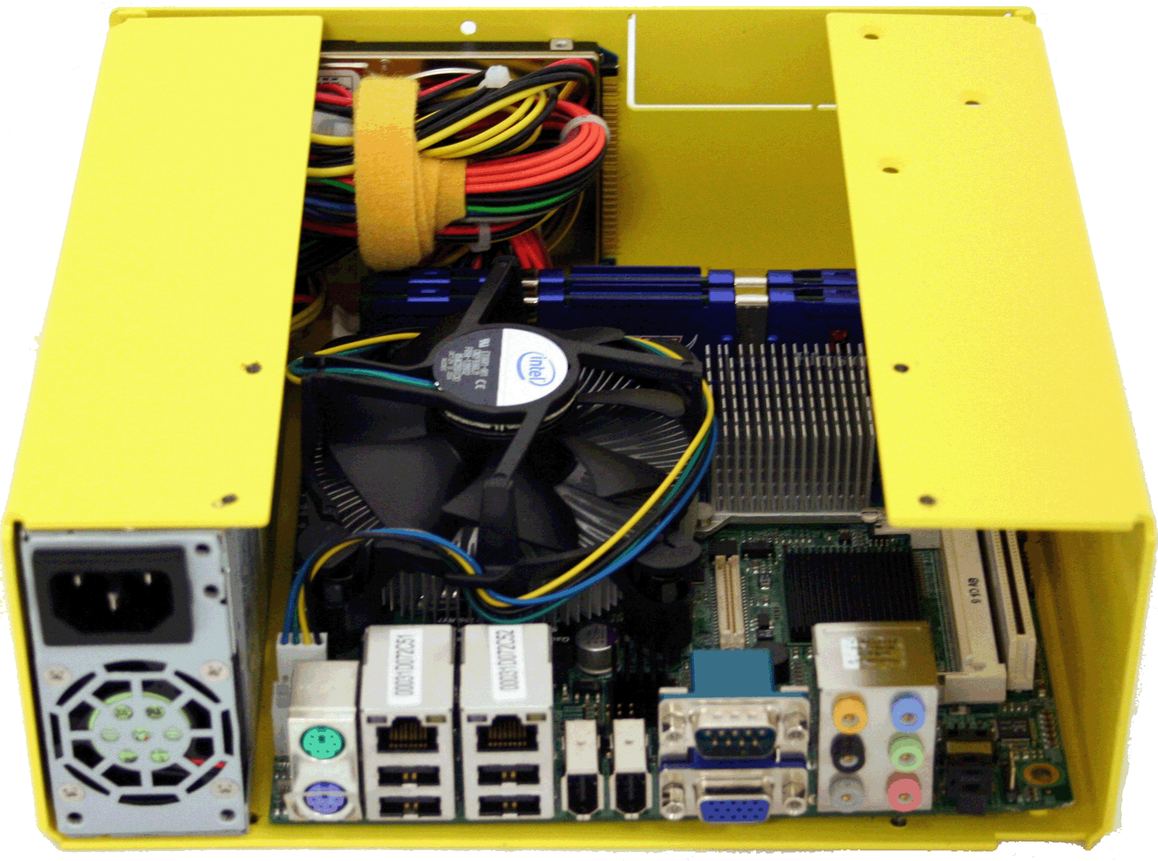
ORBIT Radio Node Versions
Version 3 (2010/2011)
Version 4 (2015/2016)
Core 2 Quad with Q35 Express chipset
4 GB DDR2
2 x Gigabit Ethernet ports
PCI-Express X16
Mini-PCI socket
8 x USB 2.0
2 x COM
Core 2 Duo with GM45 chipset
8 GB DDR3
2 x Gigabit Ethernet ports
PCI-Express X16
PCI Express mini socket
Mini-PCI socket
8 x USB 2.0
2 x COM
I7-4770 3.4 GHz Q87T Express chipset
16 GB DDR3
2 x Gigabit Ethernet ports
PCI-Express 2.0 X16
2 x Mini-PCIexpress socket
8 x USB 3.0
OOB Mgmgt.
Xeon E5-2600v3 with 18 cores
64 GB DDR4
2 x 10G Ethernet ports
2 x Gigabit Ethernet ports
PCI-Express 3.0 X16
8 x USB 3.0
OOB Mgmgt.

Slide 9
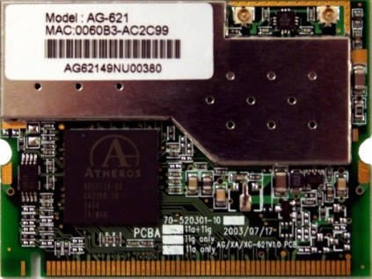
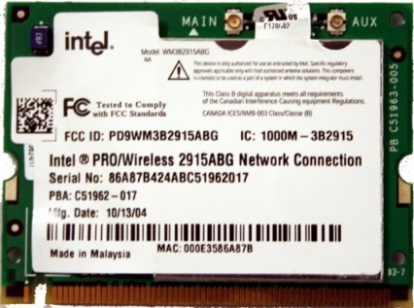
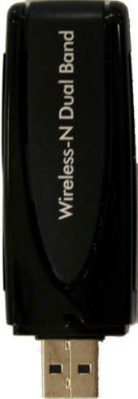
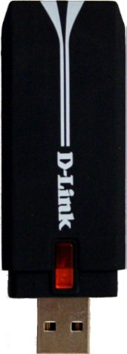
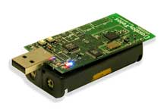
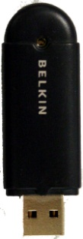
Fixed Function Radio Devices: 802.11 (a,b,g,n,ac,ad), Zigbee, BT/BLE
Atheros Dual Band (5212)
Dual-diversity with 0-18 dBm (1 dBm steps)
PCI 2.3 and PC Card 7.1
Drivers: madwifi and ath5k
Intel Dual Band 2915ABG
Dual-diversity with -12-+20 dBm (1 dBm steps)
Drivers: ipw2200
Netgear WNDA3100
Based on Atheros AR9170+AR9104
2x2 MIMO
6.5 - 300 Mbps
Driver: ath9k
D-LINK DWA-140
Based on Ralink RT2870
2x2 MIMO
20/40 MHz support
6.5 - 300 Mbps
Driver*: rt2x00
Atmega (4MHz), MSP430 (8MHz)
CC2420 250kbps 2.4GHz IEEE 802.15.4 (ZigBee) Chipcon Wireless Transceiver
Sensors - Temperature, Light, Humidity
Driver: Motes (Contiki)
Belkin F8T003 and F8T010
Bluetooth v1.1 compliant
Range of 10m (100m)
Driver: BlueZ

Slide 10
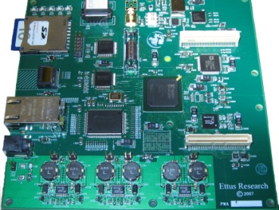
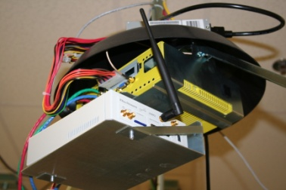
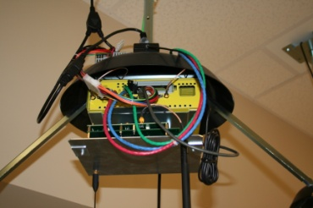
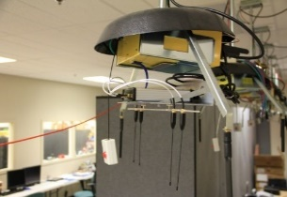
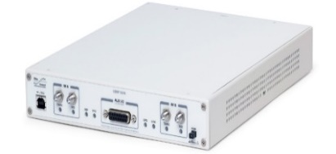
SDR Devices: USRP/USRP2/B210/X310
IF 0-100 MHz (50 MHz transmit)
128 MS/s DAC
64 MS/s ADC
USB bus (W = 8 MHz)
Channelizer code in Altera Cyclone FPGA
2 RF board slots
IF -200 MHz (80 MHz receive)
100 MS/s 14-bit dual (IQ) ADCs 400 MS/s 16-bit dual (IQ) DACs
Gigabit Ethernet (W = 25 MHz)
FPGA w/Multipliers (Xilinx Spartan 3), 1 MB SRAM
1 RF board slot
Xilinx Spartan-6 FPGA
Dual channel AD9361 RFIC transceiver (70 MHz – 6 GHz with 56 MHz baseband)
USB 3.0 connectivity
Xilinx Kintex-7 FPGA (XC7K410T)
2 x 10 Gigabit Ethernet
1 x SBX RF Daughterboard (400-4400 MHz Rx/Tx with 120 MHz baseband)
1 x CBX RF Daughterboard (1200-6000 MHz Rx/Tx with 120 MHz baseband)

Slide 11
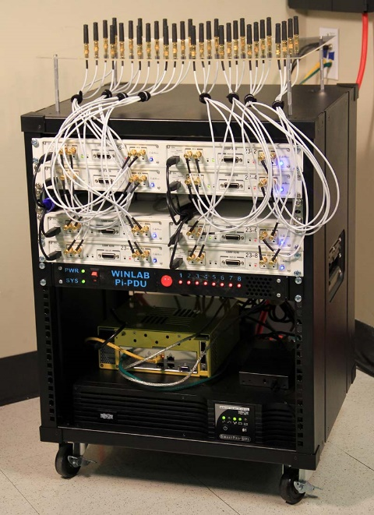
Latest ORBIT Nodes
Movable mini-racks in four corners
Core Computing with SDN
8 USRP X310s:
Dual 160 MHz baseband
2 x 10G optical Ethernet interconnects
Large Kintex FPGA with:
Rack with 32 machines:
2 x 12 core CPU
2 x 25G optical Ethernet interconnects
100G TOR SDN switch
Resource Type | Number
DSP48 Blocks | 58K
Block Rams (18 kB) | 14K
Logic Cells | 7.2M
Slices (LUTs) | 1.5M

Slide 12
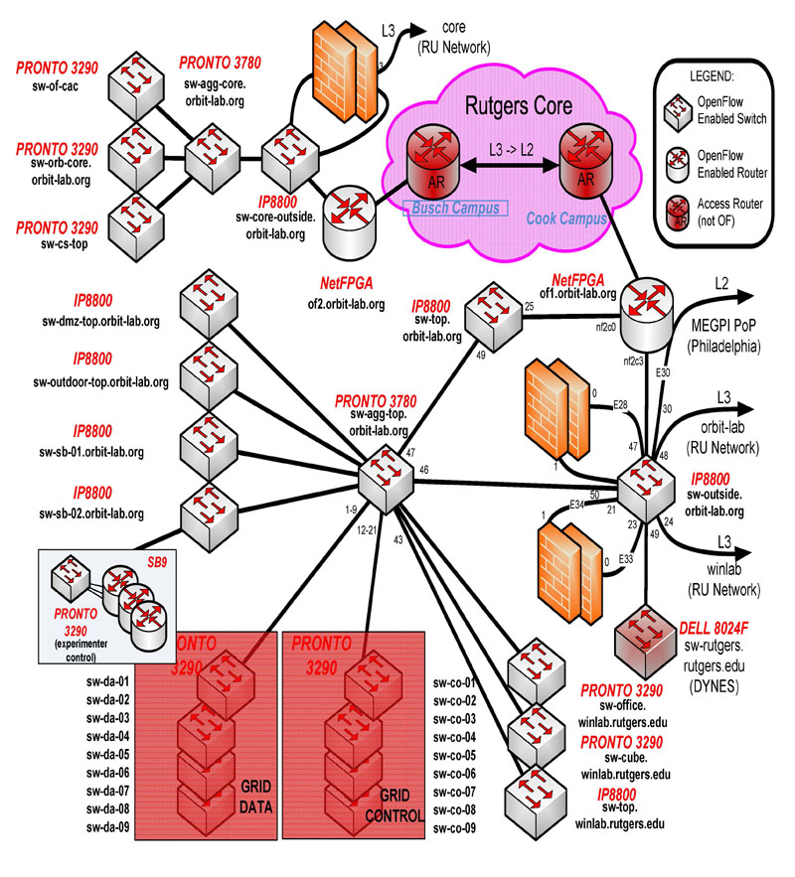
ORBIT SDN Deployment

Slide 13
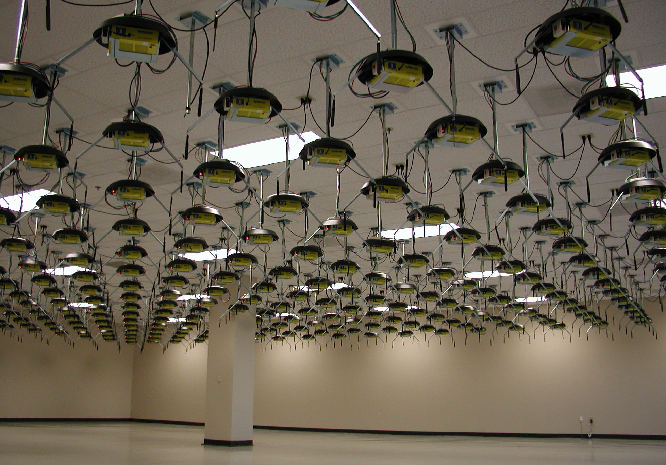
ORBIT Grid

Slide 14
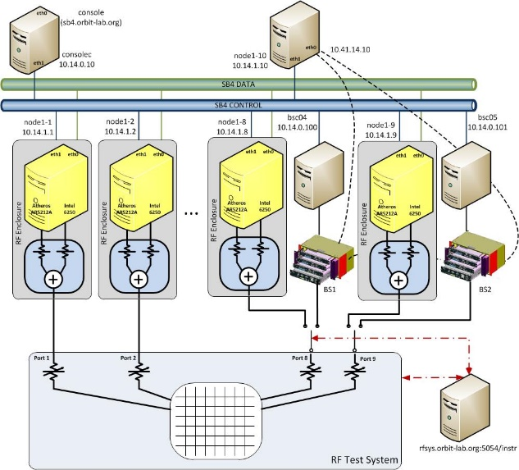
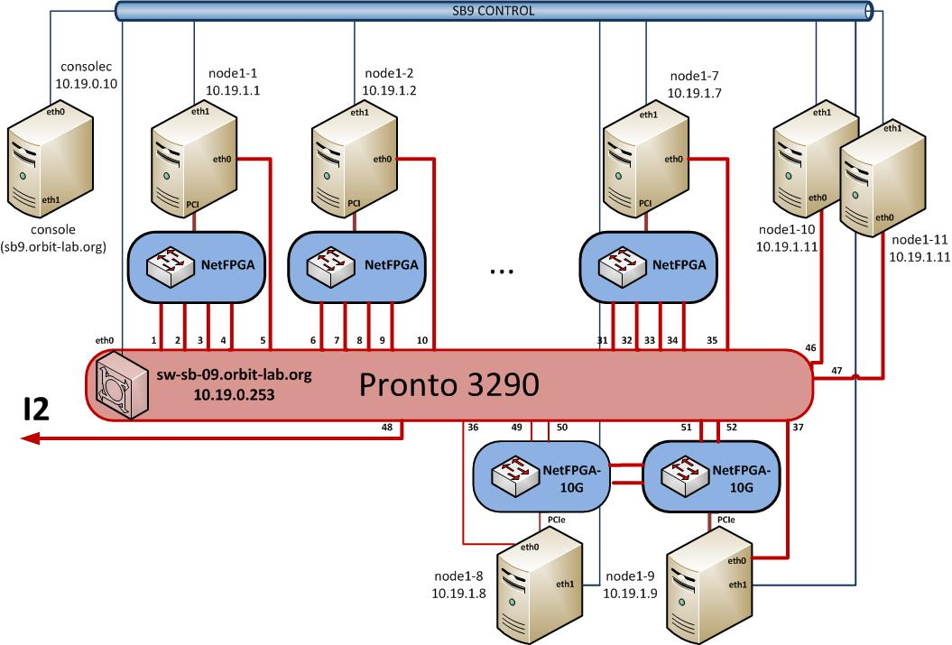
Sandboxes
To support development and reduce pressure on the grid
Console and a pair of nodes and devices focused on particular technology
Except for two specialized sandboxes:
SB4
SB9
Tight topology control
Software Defined Networking

Slide 15
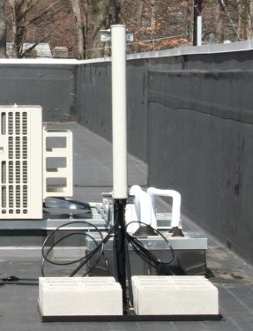
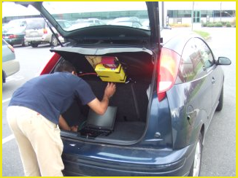
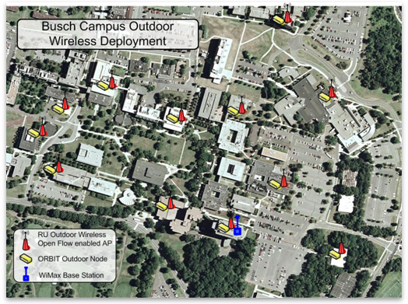
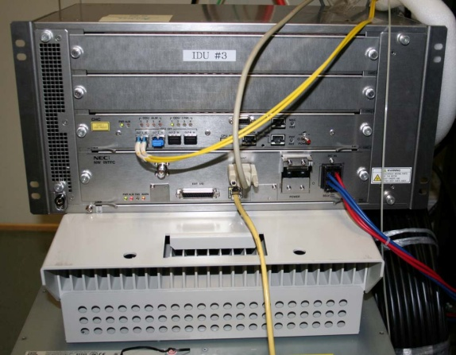
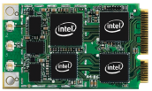
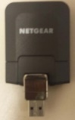
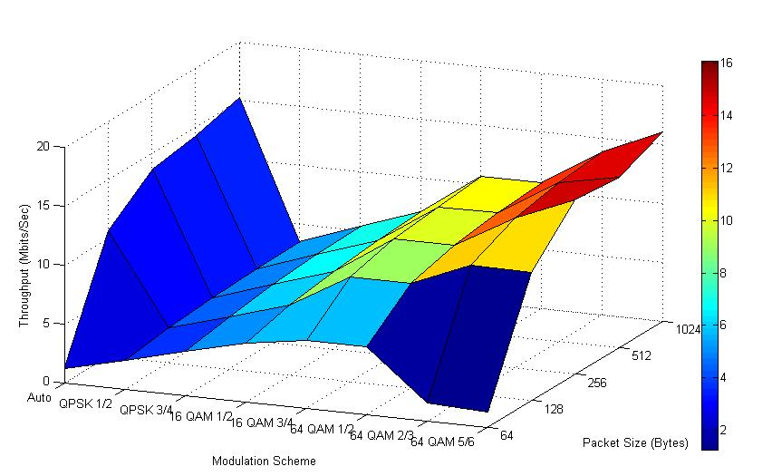
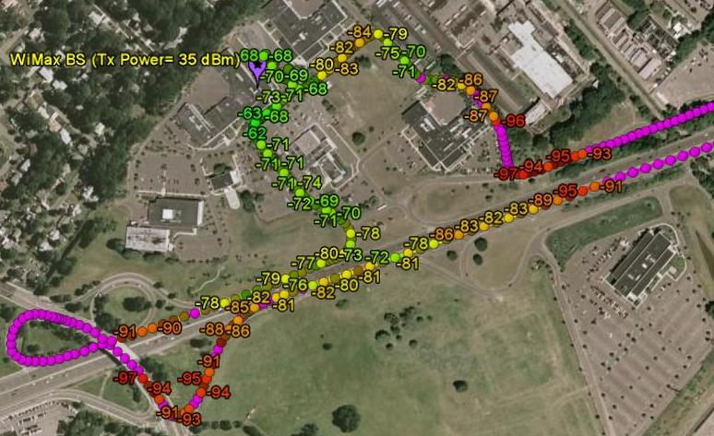
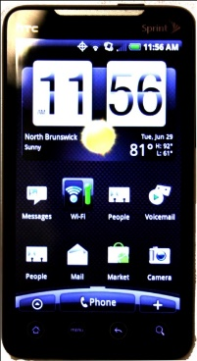
ORBIT Outdoor Infrastructure (WiMAX/LTE)
RF Module
( sector)
ORBIT
Vehicular
Node
Base
Module
Omni-directional antenna
(elev. < 6ft above roof!)
Outdoor Unit (ODU)
WiMAX: Intel 5150/5350/6250 LTE: Netgear AC341U
Android based portable platform
HTC EVO 4G
Nexus 5
Galaxy 6
Experimental readings at one location
CINR = 29 RSSI = -51
Rt. 1 Campus WiMAX Coverage
Notes:
15

Slide 16
GENI Wireless Deployment
32 LTE and WiMAX BS on 14 campuses
SDN (Click and OVS based) datapath/backbone
Sliced, virtualized and interconnected (100 Gbps) through Internet2
10 mini-ORBIT deployments some with SDRs
Kettering
U Michigan
Wayne State
UMass
U Wisconsin
Madison
Rutgers
U Colorado
Boulder
Stanford
NYU
Utah
Drexel
Columbia
UCLA
Temple
Clemson

Slide 17
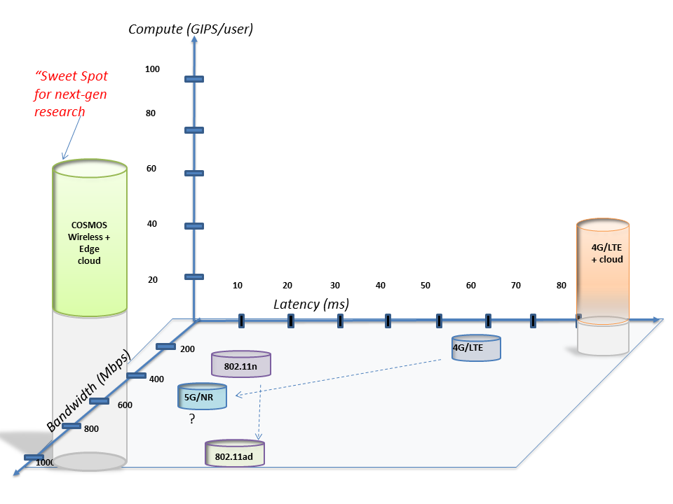
COSMOS Project Vision
Latency and compute power are the two new dimensions for characterizing wireless access
Latency for 4G cellular > 50 ms, while targets for 5G are <10 ms
Edge computing is an enabler for real-time services
COSMOS will enable researchers to investigate ultra-high speed (~Gbps), low latency (<5ms), and edge computing (~10-100 GIPS)
COSMOS = Cloud Enhanced Open Software Defined Mobile Wireless Testbed for City-Scale Deployment

Slide 18
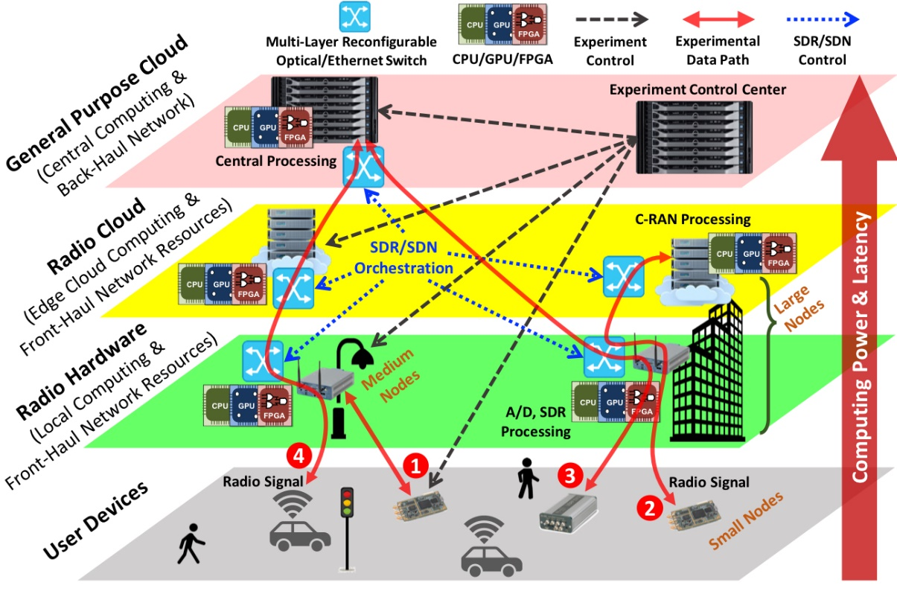
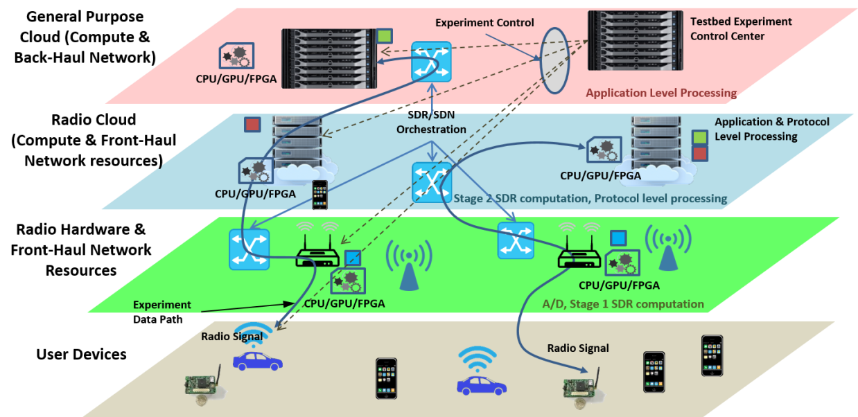
System Architecture
COSMOS architecture has been developed to realize ultra-high BW, low latency and tightly coupled edge computing
Key design challenge: Gbps performance + full programmability at the radio level
Developed a fully programmable multi-layered (i.e. radio, network and cloud) system architecture for flexible experimentation

Slide 19
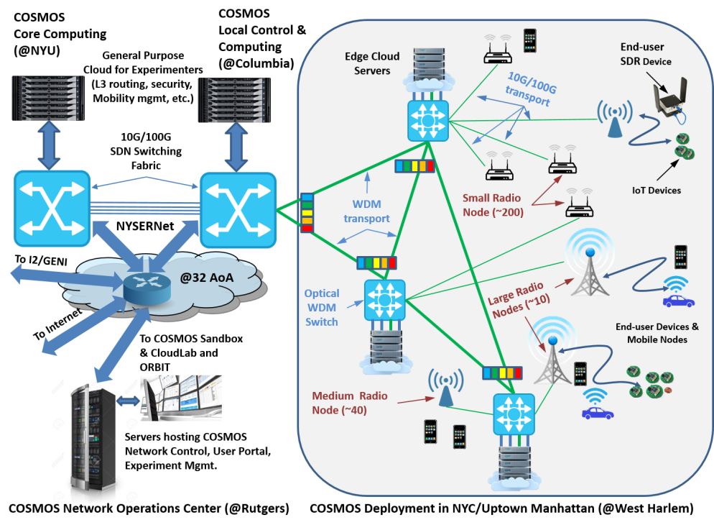
System Architecture (cont’d)
System design based on three levels of SDR radio node (S,M,L) with M,L connected via fiber to optical WDM transport
SDN-based backhaul and compute services, with access to ORBIT, GENI…
COSMOS control center and general purpose cloud at Rutgers via 32 AoA PoP

Slide 20
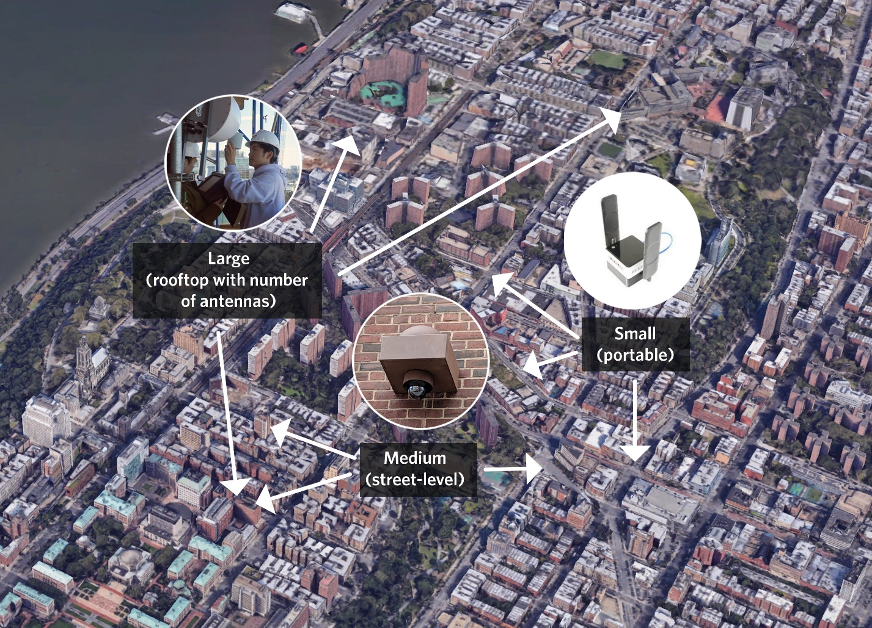
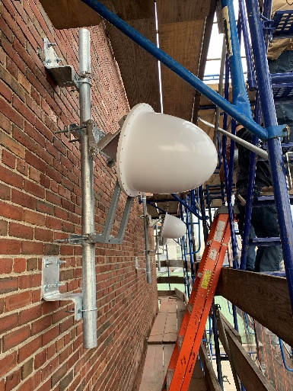
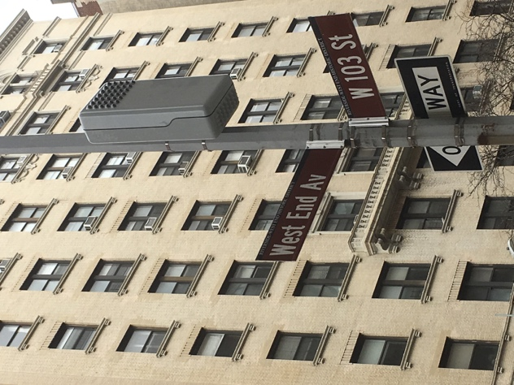
Planned Deployment
West Harlem
Area: ~1 sq. mile
~9 Large Sites ~40 Medium sites
Fiber optic connection from most sites
~200 Small nodes
Including vehicular and hand-held
Fiber connection to NYU Data Center, Rutgers, GENI/I2
Interaction with smart community & innovation initiatives (Gigabit center, etc.)

Slide 21
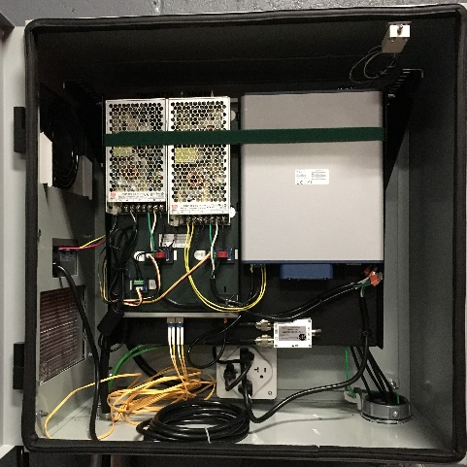
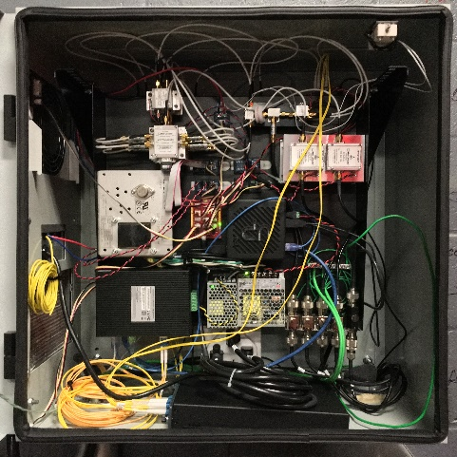
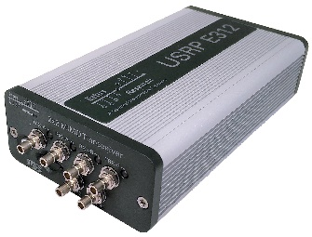
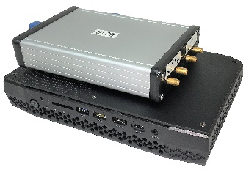
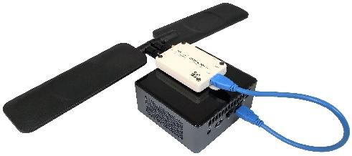
Key Technologies - SDR
All-software solution adopted for radio technology
Advanced SDR Radio Nodes at various performance levels and form factors
Design goal: 400 Mhz – 6 Ghz + 28 Ghz and 60 Ghz bands, ~500 Mhz BW, Gbps
Signal processing can be spread between radio node & edge cloud RAN
COSMOS SDR Node, SDR Tray and RF Frontend Tray
Mobile SDR Node with: B210, B205
Ettus E312

Slide 22
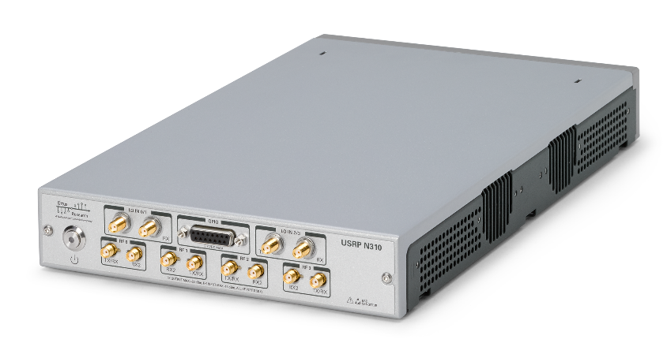
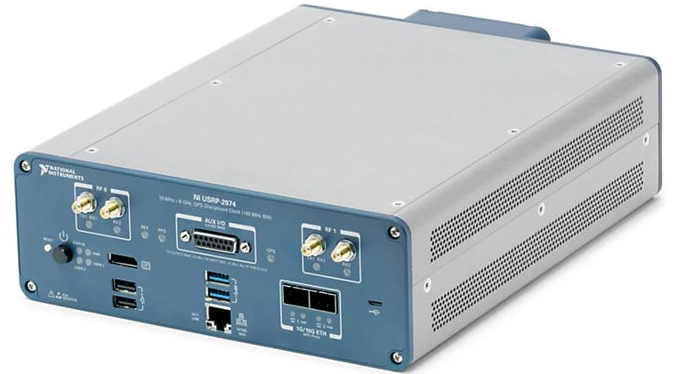
Sub-6GHz SDR Devices
USRP-N310 (Main Monitoring SDR)
System on Chip | Zynq-7100 (Dual-core ARM Cortex-A9 @ 800 MHz)
RAM | 1 GB DDR3
Ethernet | 2 x 10 Gbps
ADC/DAC | 4 x {122.88, 125, 153.6 MS/s} @ 16 bit/@ 14 bit
RF | 4 x 10 MHz to 6 GHz / 100 MHz BW
FPGA | Zynq-7100 SoC with 1GB RAM
USRP-2974 (Main Experimentation SDR)
System on module | Congatec COM Express conga-TS170 (Quad Core i7 6822EQ @ 2 GHz)
RAM | 8GB DDR4
Ethernet | 2 x 10 Gbps
ADC/DAC | 2 x 200 MHz @ 14 bit/200 MHz @ 16 bit
RF | 2 x 10 MHz to 6 GHz / 160 MHz BW
FPGA | Kintex-7 XC7K410T with 1GB RAM

Slide 23


Key Technologies – mmWave
mmWave a key new technology for the testbed, with limited availability of components
Leveraging ongoing CU collaboration with IBM to provide mmWave phased arrays (64 antennas, 8 beams) for 28 Ghz
Extensive mmWave systems expertise at NYU, including prototype systems and channel measurements
mmWave components from IBM
NYU Channel Measurements

Slide 24
Key Technologies – mmWave (cont’d)
4-chip (130nm SiGe, 166 mm2) antenna module with two operation modes: 2 x 64 element beams or 8 x 16-element beams
Performance Summary
Elements per chip | 32 TX/RX
Elements in package | 128 TX/RX
Phase resolution (deg) | 5
RMS phase error (deg) | 0.8
TX Psat (dBm) per element | 16
TX Op1dB (dBm) per element | 13.5
TX EIRP per package per pol. @Psat (dBm) | 54
H-pol, ±50°
E-plane
H-plane
V-pol, ±50°
E-plane
H-plane
Package dimensions: 70mm x 70mm x 2.7mm
Flip-chip assembly for 4 ICs
655 BGA w/ 1.27mm pitch supporting multiple power domains, IF (TX & RX) and LO signals, Digital control and ref clock signals

Slide 25

mmWave Baseband Devices
Initially: USRP based BB (2 channels @ 100 MHz) with 2 x 10 Gbps
Full deployment: RFSoC based (up to 8 channels @ 400 MHz) with 100 Gbps
RF-ADC | 8 x 4.096 Gsps @ 12 bit
RF-DAC | 8 x 6.554 Gsps @ 14 bit
Logic Cells | 930,000
Memory (Mb) | 60.5 [Mb]
DSP Slices | 4,272
33G Transceivers | 16*

Slide 26

Medium Node
Variants based on building blocks:
mmWave RF front-end
mmWave SDR BB
Sub-6GHz RF front-end
Sub-6GHz SDR BB
Sub 6GHz monintoring RF front-end
RF-over-fiber
10/100G (Ethernet+Optical)
Standard compute platform (PC)
WiFI devices

Slide 27




Key Technologies – Optical Net
MEMS Switch
Fast and low latency optical x-haul network using 3D MEMS switch and WDM ROADM
Configure wide range of topologies
Experiment on converged fiber/wireless networks
Enables fast front-haul/mid-haul/back-haul connectivity between radio nodes and edge cloud
SDN control plane for both optical and Ethernet switching
Leverages results from CIAN NSF ERC, EAGER dark fiber project at Columbia
ROADM (whitebox)

Slide 28
CALIENT & Lumentum
Calient MEMS Space switch
320x320 any to any optical circuit switch
~2db loss, ~25ms switching time
Openflow, netconf, etc.
Lumentum Whitebox20
20 port degree 1 ROADM
C band DWDM
Supports netconf

Slide 29

Optical Deployment View

Slide 30


Key Technologies – SDN & Cloud
SDN control plane used to control x-haul and cloud server connectivity
Open Network Operating System (ONOS) with radio API extensions
Compute clusters collocated with radio nodes (M,L) with choice of CPU, GPU and FPGA accelerators
Also, users have access to regular cloud racks for L3→ applications (GENI & CloudLab clusters at WINLAB)
SDN Switching Rack

Slide 31
DELL Switches
Data Plane switching:
Dell Z9100-ON Switches
Commodity 100g ethernet switching
Broadcom Tomahawk Chipset
Openflow 1.3
Supports alternate operating systems via ONIE
Control Plane switching:
Dell S4048-ON
Cost effective 10g switching
Used for physically separate control plane

Slide 32

Compute Nodes
Dell R740XD
Dual 12 Core CPU
192GB Ram
Dual 25G NIC w RDMA
Nvidia V100 GPU
Xilinx Alveo U200 FPGA,
2x 100g port

Slide 33

Cloud Architecture

Slide 34
Layer-2 Deployment View

Slide 35
COSMOS Summary
Focus on ultra high bandwidth, low latency, edge cloud
Open platform (building on ORBIT) integrating mmWave, SDR, and optical x-haul
1 sq mile densely populated area in West Harlem
Local community outreach
Research community:
Develop future experiments, provide input
(short term) get involved in the educational outreach
More information: https://advancedwireless.org/ https://www.orbit-lab.org https://www.cosmos-lab.org

Slide 36





Slide 37


